Slide 1
Introduction to Apache Spark
Welcome!
Class starts: 9.30 am CDT

Slide 2
Logistics
The training is 3 days long (from Tuesday to Thursday)
Each day we start at 9.30 am central time and planning to finish by 4.00 pm
One-hour lunch break (around noon) and 2 x 20 minutes break in the AM and PM
Please plan to attend to the full training and block your calendar for the entire 3 days

Slide 3
Expectations
Be nice
Be present
Ask questions, be active, use your Instructor as a “resource”
It’s OK to not know everything
Even for the Instructor!
Give feedback

Slide 4

Meet the Instructor
Software Engineer, Solutions Architect, Consultant and Technical Instructor
10+ years experience in Big Data Analytics, Machine Learning, Cloud and DevOps
Using Hadoop more than 10 years, Spark more than 7 years
Built production Big Data systems processing and storing petabytes of data
Research background in Distributed Computing
Experienced technical instructor
NobleProg partner trainer
AWS Authorized Instructor – certified by AWS Training&Certification
Andras Garzo
andras@connected-society.us

Slide 5
Course Outline
1. Introduction to Apache Spark (theory)
History, core concepts, Hadoop-vs-Spark
Understand how Spark fits into the Big Data ecosystem
Architecture, RDDs, transformations and actions, DataFrames
2. Writing Apache Spark jobs
Processing unstructured data using the RDD API
Handling structured data with DataFrame API
Spark SQL
User Defined functions
3. Apache Spark in Production
Running jobs in a multi-node environment (AWS EMR)
Testing and troubleshooting
Performance consideration and optimization
Orchestrating Spark Jobs with Apache Airflow
4. Introduction to Advanced Topics
Process streaming data with Apache Spark
Machine Learning with Spark on scale (MLlib)

Slide 6
Introduction to Spark
Apache spark
Core concepts
History
Relationship with Hadoop and other big data technologies

Slide 7
What is Apache Spark?
Unified computing engine and a set of libraries for
parallel data processing on computer clusters
(source: Spark Documentation)

Slide 8
Parallel Data Processing on Cluster
Processing Logic is defined by the user and distributed to the compute nodes by Spark
Data
Data Partition
Processing Logic
Compute Node
Data Partition
Compute nodes may exchange partial results
Result
Data Partition
Compute Node
Data Partition
Processing Logic
Data broken up into multiple chunks, called Partitions, which can “fit” into one processing node
Each data partition is processed by one of the compute nodes

Slide 9
Spark as a Computing Engine
Driver Process
Executors
Spark Session
User Code
Cluster Manager

Slide 10
Extensibility
No tight coupling with the storage solutions
Spark focuses on the compute only
Connectors are available for a variety of external data sources
And you can add more

Slide 11
Spark as a Unified Analytics Engine
Spark SQL and Structured API (DataFrames)
Spark Streaming (Structured Streaming)
Machine Learning (MLlib)
Graph Processing (GraphX)
Spark Core
Scala
Java
Python

Slide 12
Where Spark is coming from?
Functional Programming perspective
“Traditional” Big Data processing perspective

Slide 13
Transformations
Working with dataframes
Transformations
Actions
end-to-end data processing

Slide 14
DataFrames
Most common structured API
Represents a table of data with rows and columns
Think of a spreadsheet but it can be partitioned across multiple nodes

Slide 15
“Data Structures” in Spark: Resilient Distributed Dataset (RDD)
RDD
For structured and unstructured data
Can come from any data source
Familiar object-oriented programming style
Compile-time type safety (scala only)
No inbuilt optimization engine, for structured data it can be less performant
Scala/Python obj.
Scala/Python obj.
Scala/Python obj.
Scala/Python obj.
Scala/Python obj.

Slide 16
“Data Structures” in Spark: DataFrames
DataFrame
Data is organized to rows and columns
For structured or semi-structured data only
AVRO, CSV, JSON, relational databases
Schema needs to define prior ingestion, but Spark can infer the schema if needed
Provides a higher-level API abstraction
For querying, you can use SQL too
Many types of error can be caught at run-time only
In-built optimization engine

Slide 17
What is a transformation
You can express your data processing logics via transformations
You cannot change the individual elements in an RDD or a row in a DataFrame
Remember: these are immutable data structures
Every transformation will result a new RDD/DF
You can pipe together multiple transformations which allows Spark to optimize the execution
Transformations are lazy:
Does not execute before we won’t call an action
Example actions: take(…), collect(), save()
RDD
or DataFrame
RDD
or DataFrame
RDD
or DataFrame

Slide 18
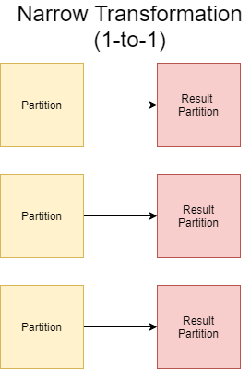
Transformation Types: Narrow Transformation
Each input partition contributes to one output partition only
Examples:
Map: apply the same transformation logic for each row
Filter/where: select specific records from RDD/DF
Projection: selecting/adding/filtering column for a DF
Easy to parallelize, independent executors does not need to exchange data (no shuffling)
Multiple narrow operations can be pipelines and can be performed in-memory

Slide 19
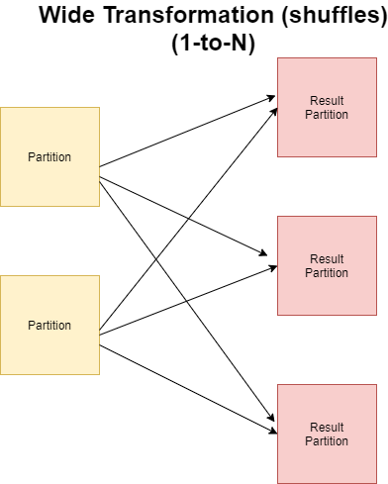
Transformation Types: Wide Transformation (Shuffles)
One input partition contributes to many output partitions
Referred as Shuffle operation, as Spark needs to exchange partitions across the cluster
Multiple wide transformations cannot be pipelined
Transformations involving data shuffling:
Group-by
Sort

Slide 20
Structured API Execution
Physical Plan
SQL
Catalyst Optimizer
Steps:
Write DataFrame code or SQL expression
Spark converts it into a Logical Plan
Spark transforms the Logical Plan into a Physical Plan while perform optimizations where it is possible
Spark executes the physical plan (sequence of RDD manipulations)
DataFrames
Datasets

Slide 21
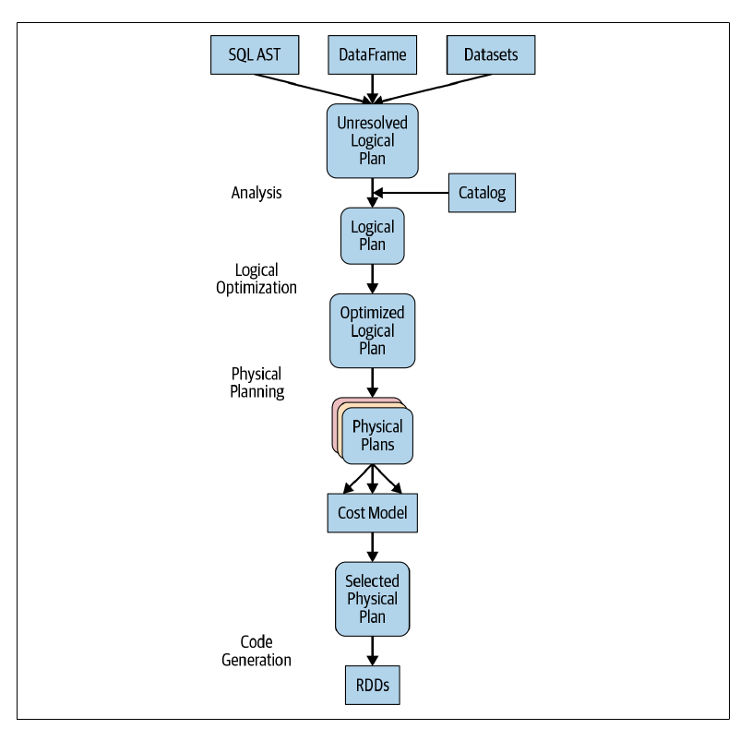
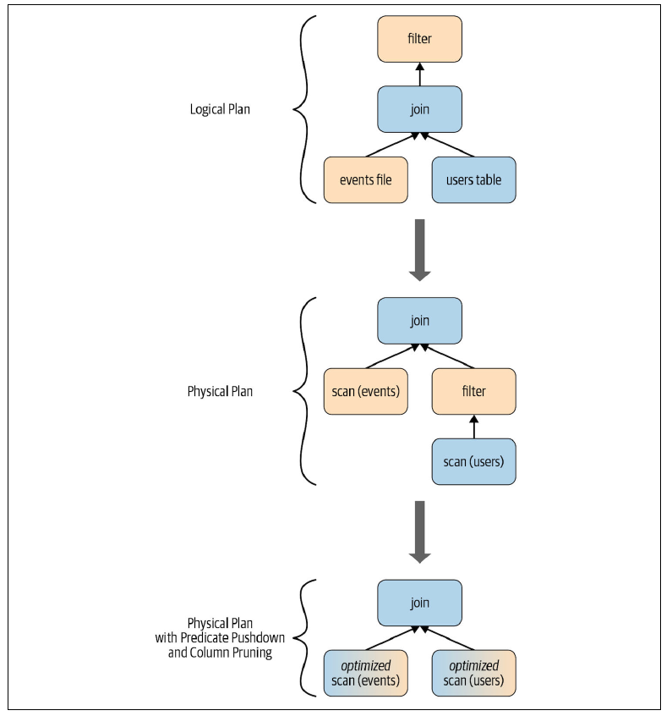
Execution Planning

Slide 22
Spark SQL

Slide 23
Spark SQL
Spark Application
JDBC/ODBC
SparkSQL Shell
Catalyst: converts computational query into an execution plan
Tungsten: enables efficient memory management, stores data rows outside of the JVM (off-heap) in a column-based memory layout
Spark SQL
Catalyst
Tungsten
JSON
PQ
Avro
ORC
Hive Tables

Slide 24
DataFrames vs SQL
SQL
DataFrames
Syntax
Errors
Runtime
Compile time*
Semantic
Errors
Runtime
Runtime
* In case of Scala. In python, Syntax errors will be revealed during Runtime as well

Slide 25
Input/Output

Slide 26
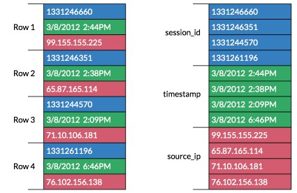
Columnar File Format
Values from same columns are grouped and stored together
As values has the same type, it can be stored in a more compact way than the individual records
To scan through all the values of a specific column, you don’t need to read the entire table
Significantly can speed up query time
Most prevalent columnar formats:
Parquet (PQ)
ORC

Slide 27
Partitioning
Timestamp
Name
TS = [1, 2, 3]
1
Bob
1
Bob
2
Alice
2
Alice
3
Bob
3
Bob
Partitioning
4
Bob
TS = [4, 5, 6]
4
Bob
5
Alice
5
Alice
6
Alice
6
Alice

Slide 28
Bucketing
Timestamp
Name
Alice
1
Bob
1
Bob
3
Bob
2
Alice
Bucketing
4
Bob
3
Bob
4
Bob
Bob
2
Alice
5
Alice
5
Alice
6
Alice
6
Alice

Slide 29
Joins

Slide 30
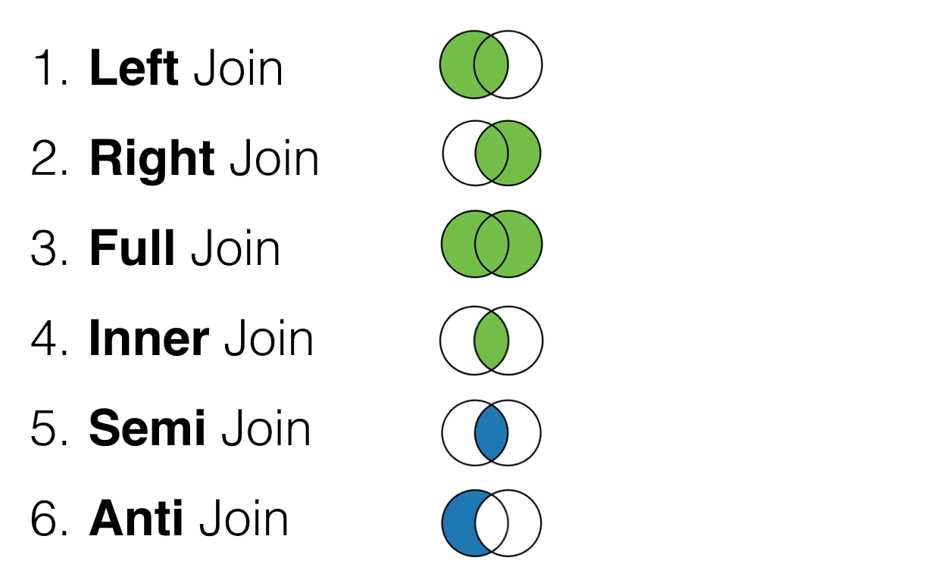
Join Types
Inner Joins: keep rows with keys that exist in both (left and right) tables
Outer Joins: keep rows with keys either in left or right tables
Left outer joins: keep rows with keys in the left table
Right outer joins: keep rows with keys in the right table
Left semi join: keep the rows in the left table where the key appears in the right
Left anti joins: keep the rows in the left where they do not appear in the right table

Slide 31
Join Strategies in Spark
Broadcast Hash Join (BHJ)
Shuffle Hash Join (SHJ)
Shuffle Sort Merge Join (SMJ)
Broadcast Nested Loop Join (BNLJ)
Shuffle-and-replicated nested loop join (aka. Cartesian product)

Slide 32
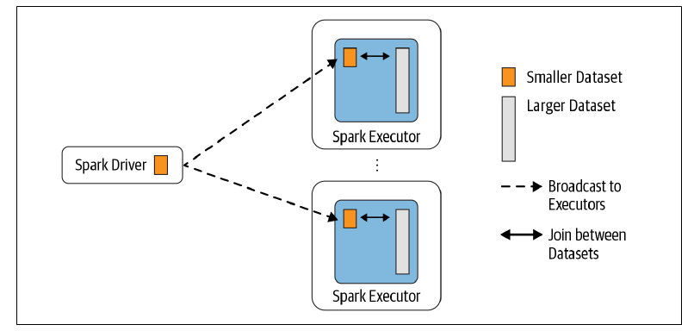
Broadcast Hash Join
One table is much smaller, fits into the memory on one node
Threshold for BHJ can be configured, by default it is 10 MB
Use “broadcast” keyword to give a hint for Spark to Broadcast Join
May not be enforced

Slide 33
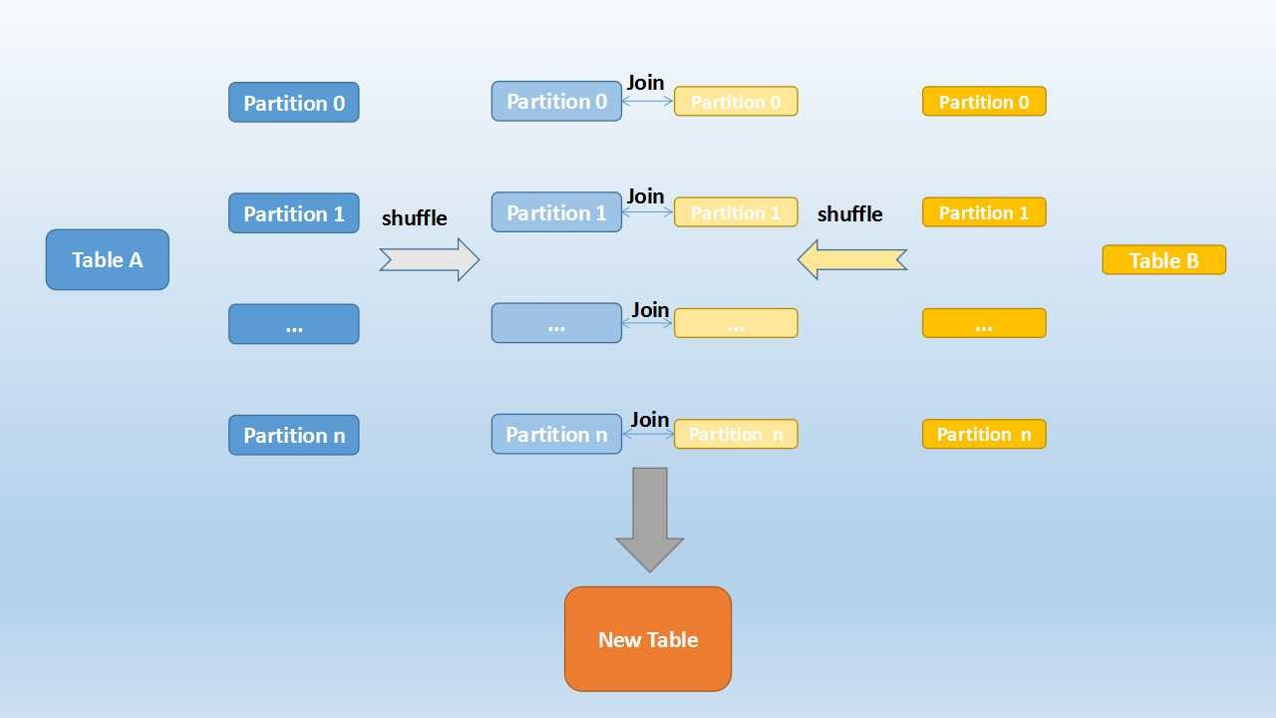
Sort-Merge Join
Shuffle phase: re-partioning by key
Sort phase: sort partitions by key
Merge Phase
You can speed it up if you have co-located partitions

Slide 34
Performance Tuning

Slide 35
Topics
Maximizing Parallelism
Caching and Persisting intermediate results
Tuning Spark Shuffling service

Slide 36
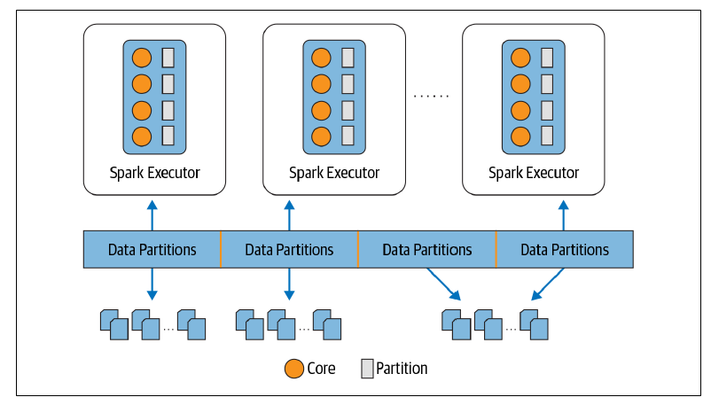
Partitions and Parallelism
Ideal case: #Partitions >= #cores
Partitions are the atomic units of parallelism

Slide 37
Which operation creates partitions?
File read
Partitions number is determined automatedly based on the size and the number of files
E.g. one file will be divided into 128 MB partitions (it is configurable)
Or each file will go to separated partition (this is not configurable)
“Small files problem”. Lots of small files can eat up the performance
Shuffling
It is fixed how many partitions are created during shuffling (default is 200)

Slide 38
Writing Production Spark Code

Slide 39
Generic Advices
Test your code locally before deploying
Use Spark only when it is necessary (less is often more!)
Mind your dependencies
De-couple data pipeline and I/O

Slide 40
Testing Best Practices
Work your local dev. Environment first
Always test your pipeline locally
… But don’t forget the end-to-end test in real production-like system
Test your job with:
Developer defined data
Sampled data from production system
Generated data (statistics for sampling derived from production)
Get exact input/output datasets from business and integrate with continuous testing

Slide 41
Optimizing Spark Jobs
Use PQ if you process the output further
Tune the number of shuffling partitions (spark.sql.shuffle.partitions)
Tune the number of executors, executor memory size and executor core size

Slide 42
End-to-End Spark Based Data Pipeline
Goals:
Putting everything together what we learnt
Write a complex scalable data pipeline in spark which interacts multiple data sources and databases
Learn how to write production spark code with tests
How to optimize your job at scale

Slide 43
Task: Process Apache access log files
100s of GB Apace HTTP server access.logs generated every day
You need to implement a horizontally scalable solution, when you can process the new log files each day
The security team needs to get some basic statistics, like number of HTTP error codes per server or resource. This aggregated data need to be stored in a relational data warehouse as they need instant and quick access
The sanitized and structured data needs to be stored on a Data Lake and can be queried via SQL in case an incident happens and needs the raw data for the investigation
Some events also can trigger alarms. For example, if in an hour window several specific error codes suddenly exceeds a pre-defined threshold, a notification needs to be raised

Slide 44
Solution Outline
alarm_df
Spark Based Data Processing Pipeline
Notification Service
“Calculate” Alarms
Input Folder
Trigger
Extract and Transform
Daily data dumped into an S3 bucket
Aggregate and Load
stat_df
log_df
MPP Query Engine
Datalake
DWH

